Slide 1


Functional Testing

Slide 2

CONTENTS
What is Functional Testing?
Functional Testing Process
Type of Functional Testing Techniques

Slide 3

01
What is Functional Testing?
Functional testing is basically defined as a type of testing that verifies that each function of the software application works in conformance with the requirement and specification. This testing is not concerned with the source code of the application. Each functionality of the software application is tested by providing appropriate test input, expecting the output, and comparing the actual output with the expected output. This testing focuses on checking the user interface, APIs, database, security, client or server application, and functionality of the Application Under Test. Functional testing can be manual or automated.

Slide 4


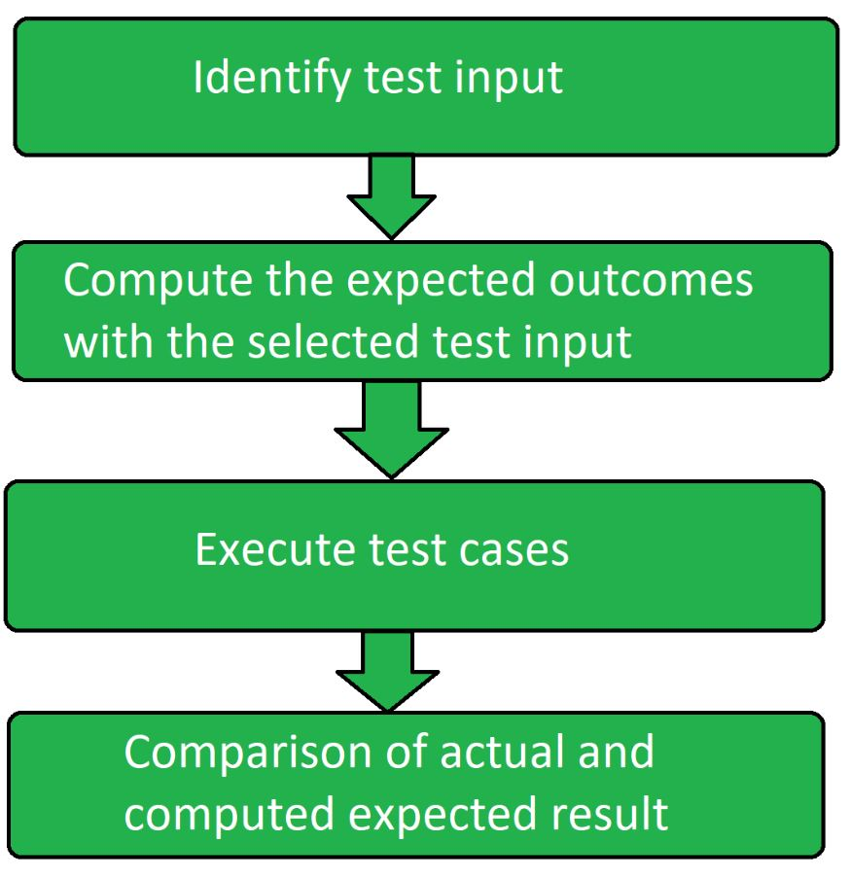
Functional Testing Process
Identify test input: This step involves identifying the functionality that needs to be tested. This can vary from testing the usability functions, and main functions to error conditions.
Compute expected outcomes: Create input data based on the specifications of the function and determine the output based on these specifications.
Execute test cases: This step involves executing the designed test cases and recording the output.
Compare the actual and expected output: In this step, the actual output obtained after executing the test cases is compared with the expected output to determine the amount of deviation in the results. This step reveals if the system is working as expected or not.

Slide 5
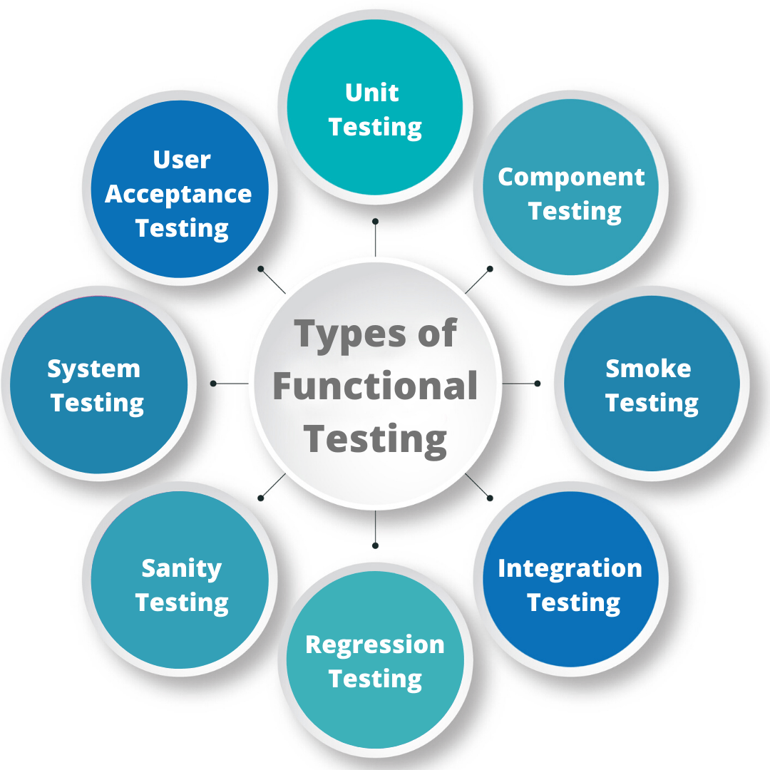
Type of Functional Testing Techniques
Unit Testing
Integration Testing:

Slide 6
Unit Testing
Unit testing is the type of functional testing technique where the individual units or modules of the application are tested. It ensures that each module is working correctly.
Objective of Unit Testing
The objective of Unit Testing is:
To isolate a section of code.
To verify the correctness of the code.
To test every function and procedure.
To fix bugs early in the development cycle and to save costs.
To help the developers understand the code base and enable them to make changes quickly.
To help with code reuse.
Usefull for the documentation.

Slide 7
Advantages of Unit Testing:
Unit Testing allows developers to learn what functionality is provided by a unit and how to use it to gain a basic understanding of the unit API.
Unit testing allows the programmer to refine code and make sure the module works properly.
Unit testing enables testing parts of the project without waiting for others to be completed.
Early Detection of Issues: Unit testing allows developers to detect and fix issues early in the development process before they become larger and more difficult to fix.
Disadvantages of Unit Testing:
The process is time-consuming for writing the unit test cases.
Unit Testing will not cover all the errors in the module because there is a chance of having errors in the modules while doing integration testing.
Unit Testing is not efficient for checking the errors in the UI(User Interface) part of the module.
It requires more time for maintenance when the source code is changed frequently.

Slide 8
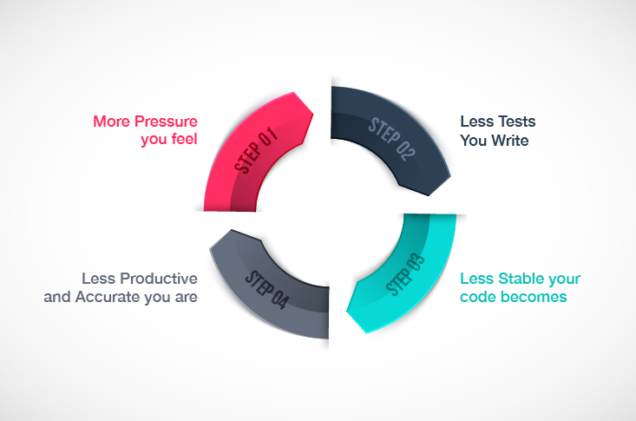
Example: a restaurant needs an app that helps customers order at their tables without a server. The developer would create a unit test to examine the “add to order” function. Other individual functions such as “remove from order” or “submit order” would also go under unit testing.

Slide 9
Integration Testing
Integration testing is the process of testing the interface between two software units or modules. It focuses on determining the correctness of the interface. The purpose of integration testing is to expose faults in the interaction between integrated units. Once all the modules have been unit-tested, integration testing is performed.
Types of integration testing
Big-Bang Integration Testing
Bottom-Up Integration Testing
Top-Down Integration Testing
Top-Down Integration Testing

Slide 10
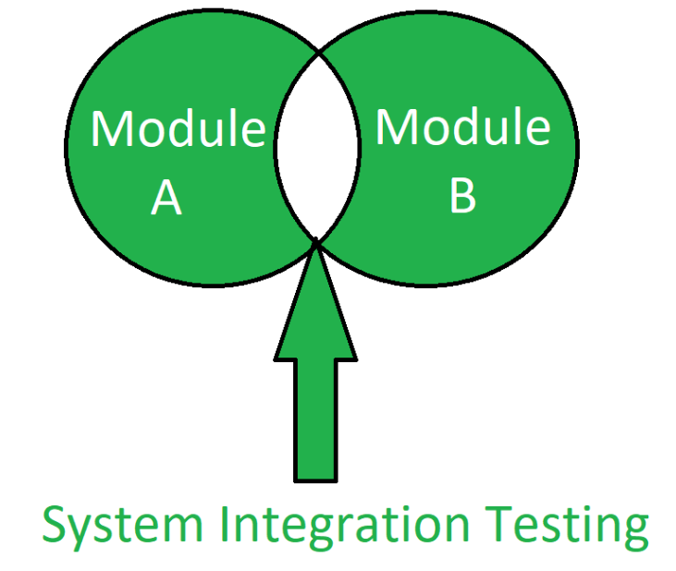
Example: A banking app has a function where users can set up a saving account. It includes a money-transferring capability from their main account to the saving account. As they are separate modules, testers need to perform integration testing to ensure that the transactions happen smoothly and correctly between the two.

Slide 11
Thank you
HARI HARAN D

